Slide 1

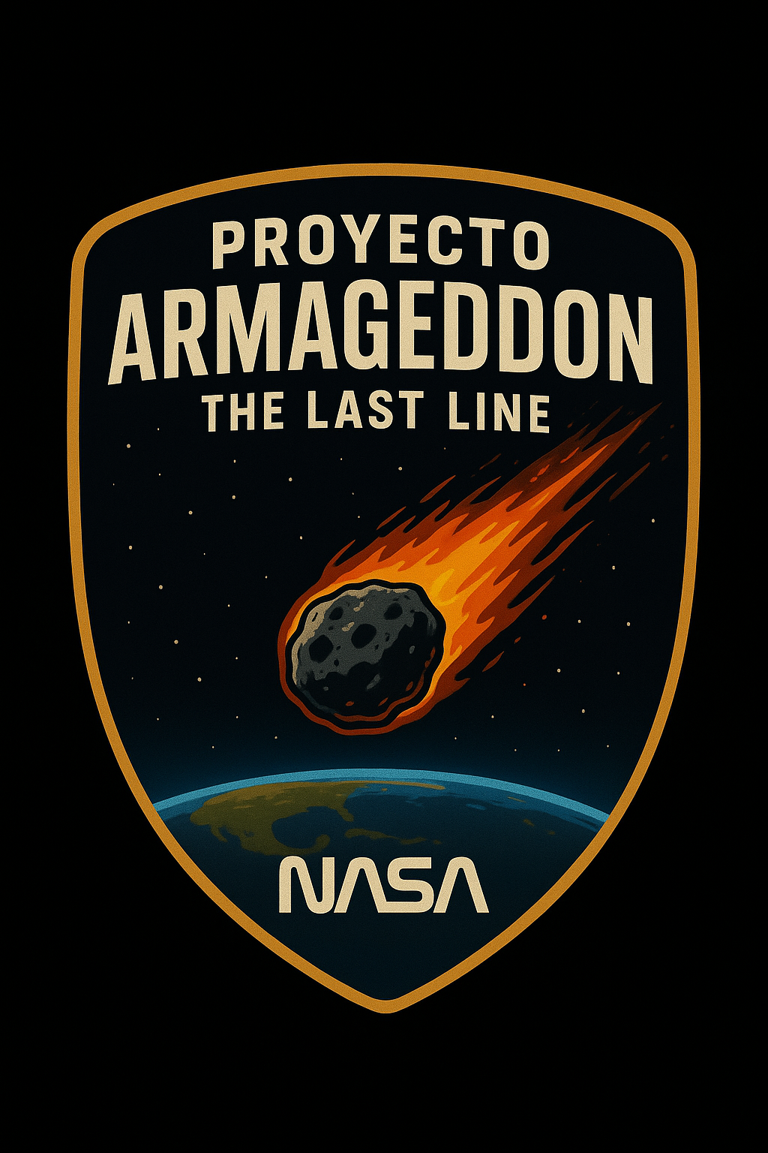


CHICLAYO
Brief description
Inspired by the film Armageddon, Project Armageddon aims to create technological solutions for planetary defense and orbital and asteroid impact simulations.
The team is made up of Systems Engineering students passionate about technology, science, and innovation, along with a space economics specialist who analyzes asteroid mining as a sustainable source of resources.

Slide 2
RETO NASA SPACE APPS CHALLENGE
Problems of the “Meteor Madness” Challenge – NASA Space Apps Challenge 2025
The challenge arises from the potential threat of a near-Earth asteroid, called Impactor-2025. Although asteroid impacts are rare, they can have catastrophic consequences such as tsunamis, earthquakes, and atmospheric changes. Currently:
🔴 Data is fragmented: NASA and USGS have valuable information, but it is not integrated or easily accessible for simulations.
⚠️ Lack of accessible tools: Existing platforms are either too technical or too simple, limiting their usefulness for scientists, decision-makers, and the public.
🚫 Weak simulation capabilities: There are no tools that allow visualizing impacts, evaluating mitigation strategies (such as trajectory diversion), or understanding environmental effects in a clear and educational way.
The challenge is to create an interactive tool that simulates impact scenarios, visualizes consequences, and proposes mitigation strategies using real NASA data.
ODS : 11,13,17

Slide 3
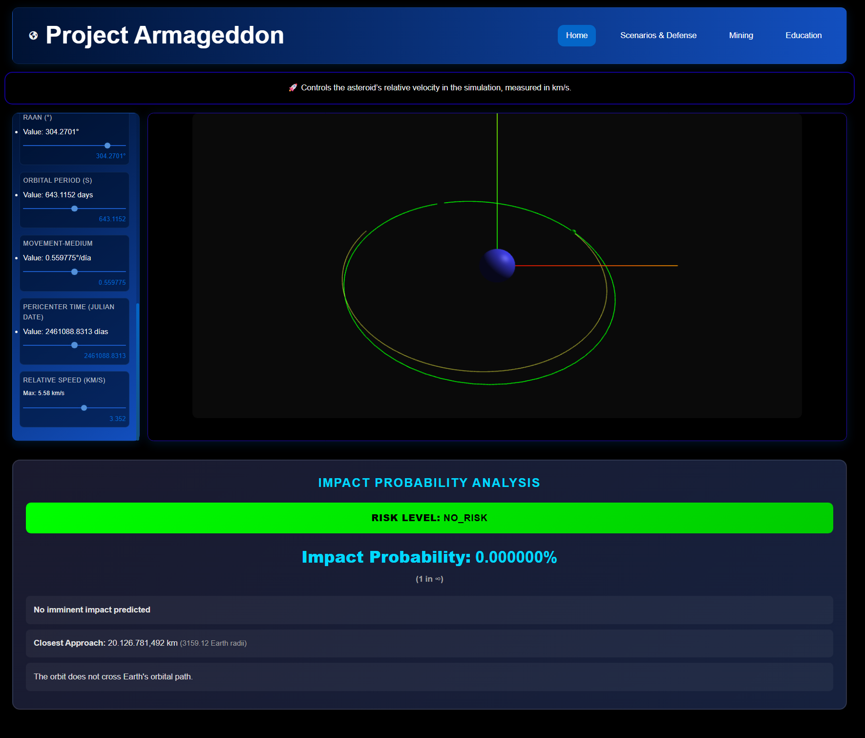
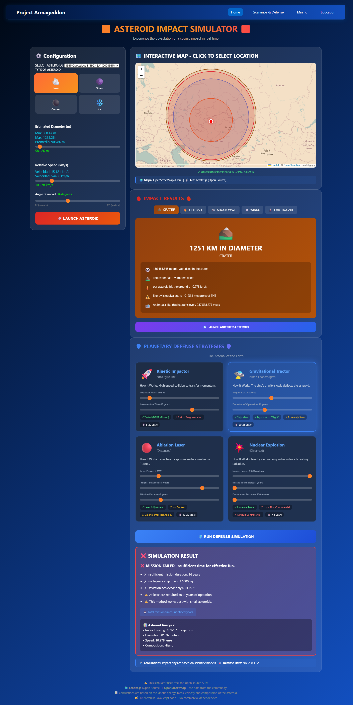
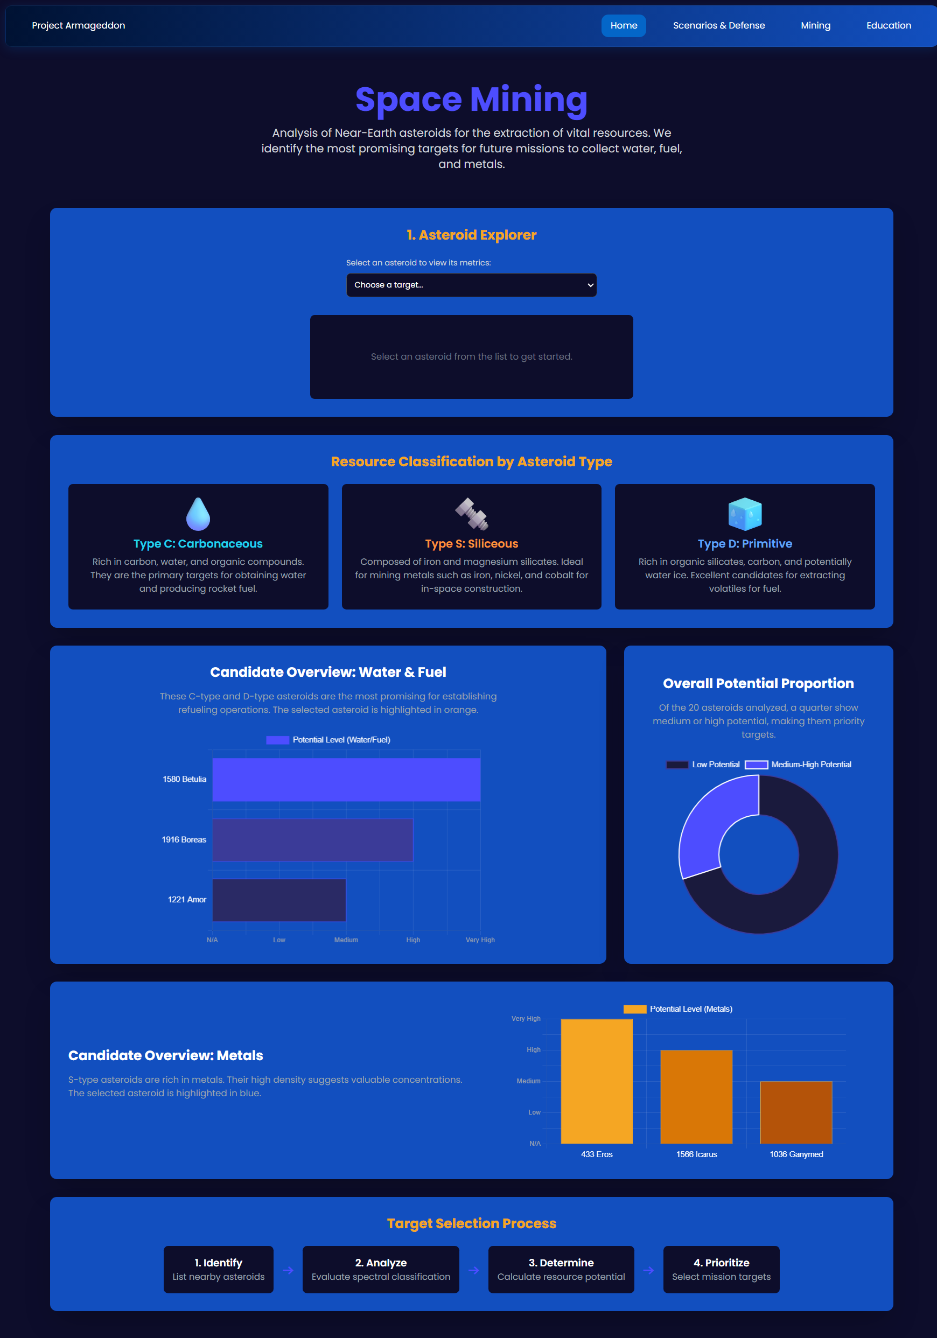
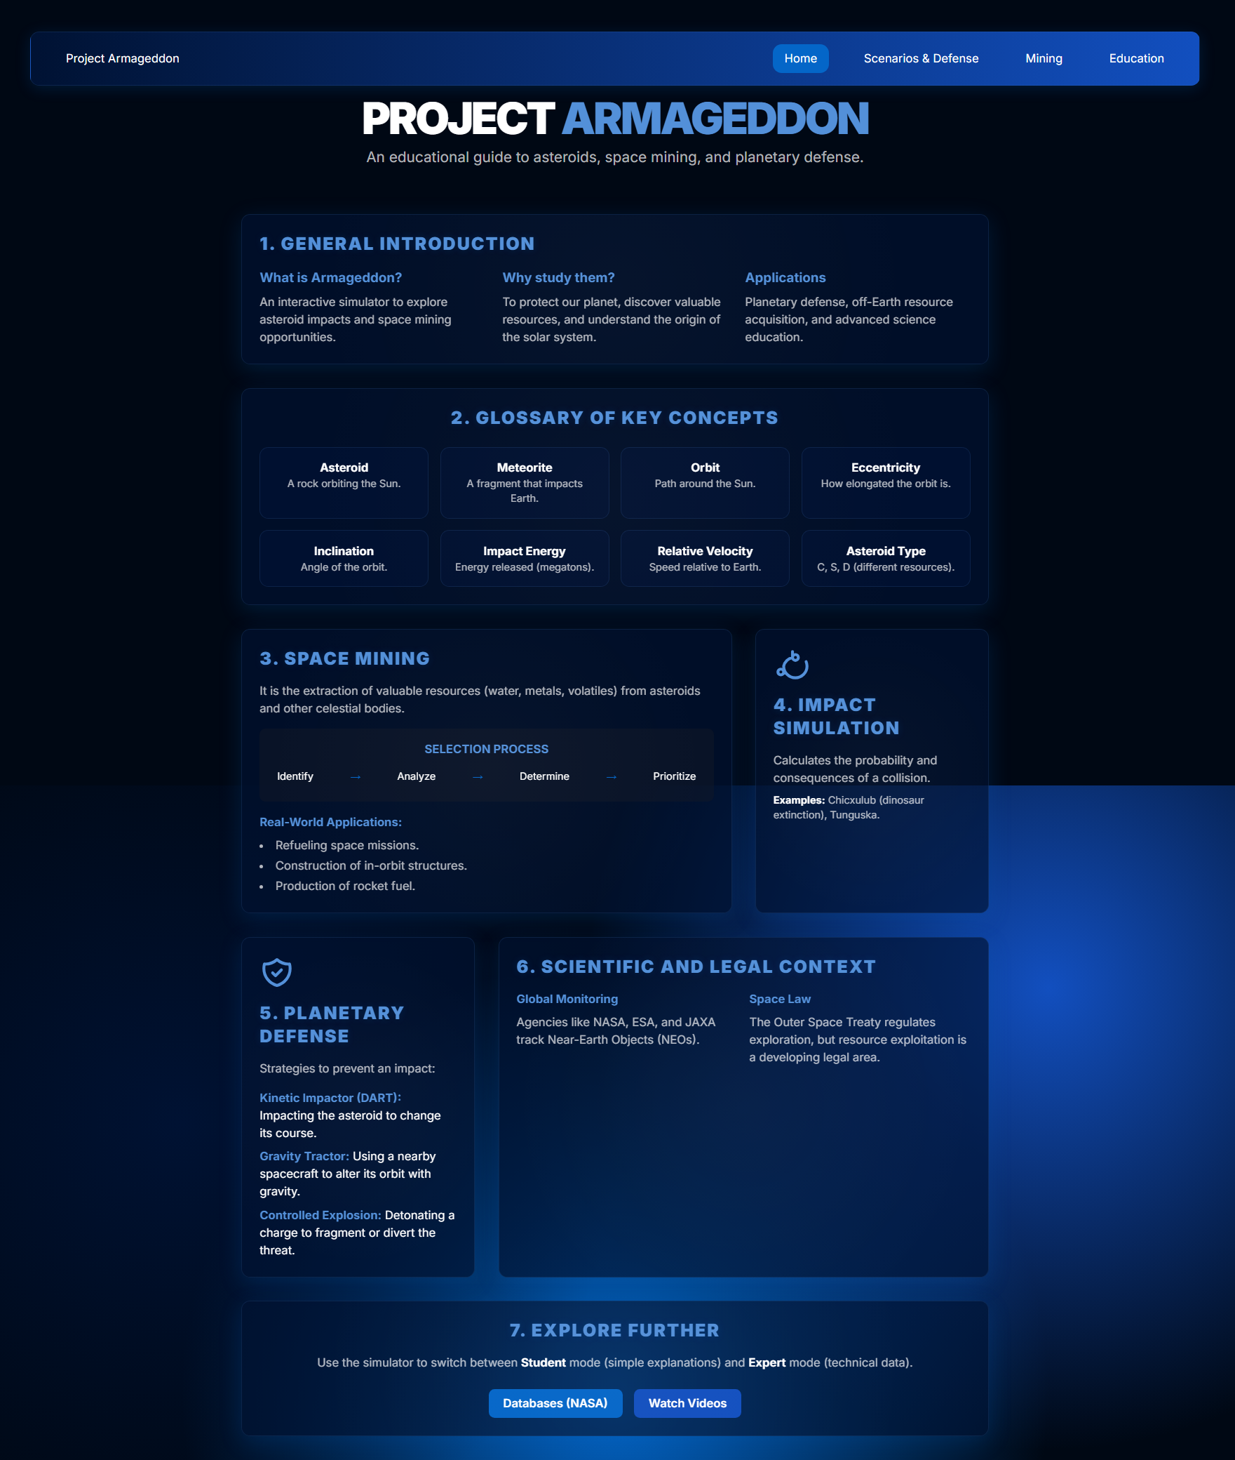
PROTOTYPE
Interactive website that simulates the orbital behavior and impact of meteorites in real time. It allows users to analyze consequences, test planetary defense strategies, explore space mining, and access educational materials to understand the phenomena and their scientific use.
Website : Asteroid Impact Simulator

Slide 4
BENEFICIARIES
Group of beneficiaries | How they benefit
🧑‍🔬 Scientists and researchers | They access a tool that integrates real-world data (NASA and USGS) to model impacts and validate hypotheses.
🧑‍💼 Decision makers | They can visualize risk scenarios and evaluate mitigation strategies to protect populations.
🧑‍🏫 Educators and students | They get an interactive platform to learn about asteroids, orbital physics, and natural disasters.
🌐 General public | Gain a better understanding of astronomical risks through accessible and educational simulations.
🏛️ Risk management agencies | They use the tool to support contingency plans for impact threats.
🧑‍🚀 Space and technology community | The development of innovative solutions for planetary defense and space mining is promoted.

Slide 5

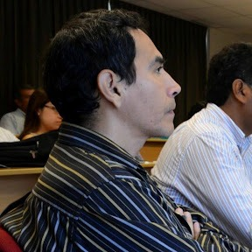
TEAM
Christopher Anthony Bardales Monja
Systems Engineering Student
CEO/CTO
Javier Gustavo Ortega Quiroz
Economist
COO

Slide 6
THANK
YOU
spaceappschallenge.org

